Slide 1
Trees and Stormwater
Barley Van Clief
PHS Tree Tenders Program Manager
Vinnie Cotrone
Penn State Extension Urban Forester
Notes:
Welcome to this Green Infrastructure Maintenance Training. This presentation is one of several in the training series.
You can view the entire series sequentially, or each module independently.

Slide 2
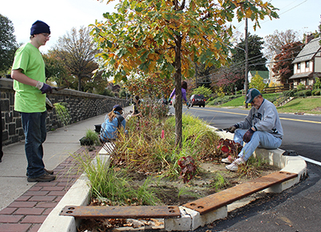
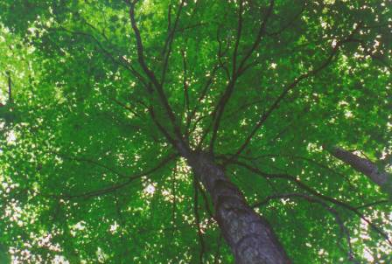
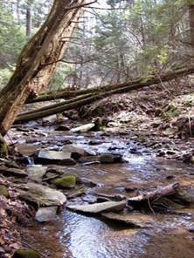
Overview
What role do trees play in stormwater management
How can we choose the best trees for the purpose
What do we need to know about tree biology for understanding maintenance practices
How can we establish and maintain trees for best growth.
Notes:
In this presentation you will learn
Why trees are an important contributor to green infrastructure and what role they play in stormwater management;
How to choose the best trees for the purpose;
Basic tree biology for understanding maintenance practices;
How to establish and maintain trees for best growth.

Slide 3
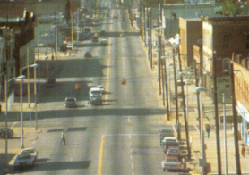
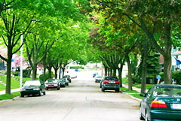
Trees: An Invaluable Part of Our Community Infrastructure…
Trees are Essential Contributors to
  Our Environment
  Our Health
  Our Economy
  Our Youth
  and more…
Why have this …
…when you can have this !
Notes:
Trees are an important part of our community infrastructure. In the past, the word “infrastructure” most often referred to buildings, roads, power supplies and the storm sewer pipes underground. In more recent years, the contribution of plants to the functionality of our society has been recognized, and the word “green infrastructure” has become part of the vernacular. Trees have so MANY benefits – all of these listed here and more.

Slide 4
Trees and Stormwater
1 inch rainfall = 27,000 gallons per acre
Notes:
Right now, we’ll just focus on the contribution trees make to controlling stormwater runoff. Even a short, light rainfall can produce a lot of water. Let’s see what happens to those 27,000 gallons of water.

Slide 5
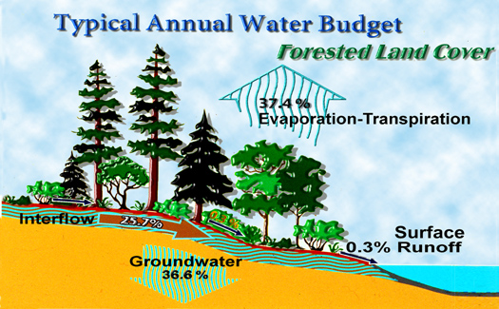
Hydrology Under Natural Conditions
Courtesy May, U of W
Notes:
Under natural conditions almost all of the water from each rainfall event is intercepted by the forest and returned to the atmosphere through evapotranspiration or trapped on the forest floor and slowly infiltrated into the ground. There is very little surface runoff. The water that infiltrates is critical to maintaining the base flows of streams. The temperature, volume, and quality of this base flow is crucial for helping to maintain the habitat for sensitive aquatic species like trout.

Slide 6
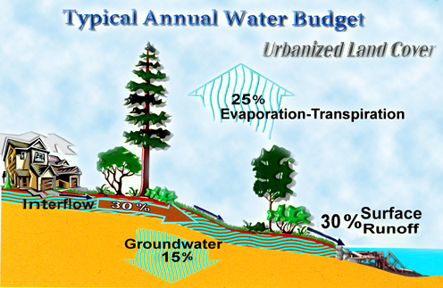
Hydrology in Developed Conditions
Courtesy May, U of W
Notes:
When land is developed, the frequency, volume and flow rate of surface runoff increases dramatically to 30%. In some urban areas, more than 75% of the rainfall does NOT soak into the ground because of impervious areas like roads or roofs, and compacted soil.

Slide 7
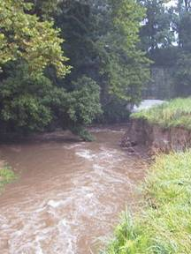
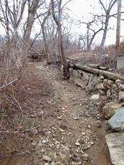
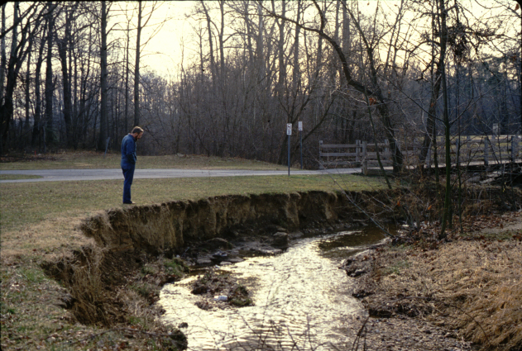
Impact on Streams
..
Impervious surfaces challenge healthy
streams with:
Non-point source pollution
Streambank erosion & channelization
More extremes: Floods to Dry
Notes:
There are lots of changes to watersheds caused by urbanization. The picture on the left is a healthy, forested stream, shallow and meandering.
Impervious surfaces like roads, roofs and parking lots cause the water to run across the surface of the ground. The energy of the water picks up pollutants and carries them to the stream, which degrades water quality and aquatic habitat. This is called non-point source pollution.
Fast moving water picks up whatever it encounters, including soil from unprotected streambanks. Since the rushing water “wants” to go straight and not follow curved streambeds, prolonged exposure to flooding will erode the streambanks until they are channelized & straight. The water carries particles of silt, making the stream unsuitable for aquatic life.
Flash Flooding is a man-made phenomena caused by the impervious surfaces and a quick heavy rainfall. If you watch the news, you’ll know that Flash Flooding is on the increase, but it does not happen in the forest.
Impervious surfaces reduce the ability of the land to capture and retain water, changing the availability of water for ecosystem functions as well as human services. Since groundwater is the main source of water to recharge streams, they will become dry after flooding.

Slide 8
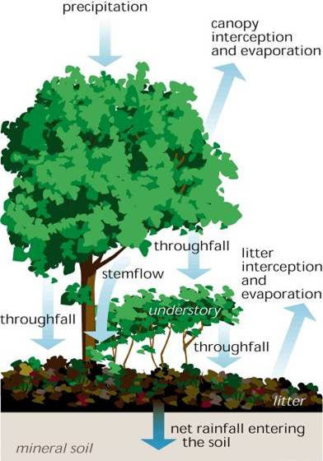
Trees and Storm Water
Trees:
Intercept 67% of rainfall.
Filter and regulate the flow of water.
Store water as they grow.
The forest floor, absorbs precipitation before gradually releasing it into natural channels and watercourses
(sub-surface flows)
Notes:
The forest acts like a big sponge, absorbing rainfall. In a forested setting, the leaves of each tree intercept 67% of the rainfall hitting the tree’s canopy, reducing peak flow, which is the maximum rate of runoff discharge during a storm event. The multi-layered forest captures a great deal of the rainfall in the leaves, stems, and leaf litter layer before it even reaches the soil. Then the rain water percolates slowly into the organic-rich forest soils. It is used by the plants for growth and respiration, or evapotranspiration, and the remainder slowly moves to the streams in sub-surface flows.

Slide 9
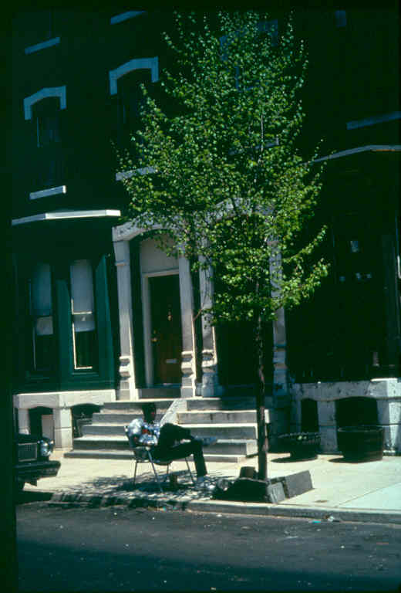
Choosing the Right Tree for the Job
Notes:
In an urban or suburban setting, trees still help to intercept and infiltrate stormwater. But it’s important to choose species that are appropriate for each planting site. The goal is to have the trees survive to maturity so that they can provide the most benefits.

Slide 10
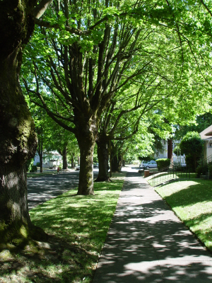
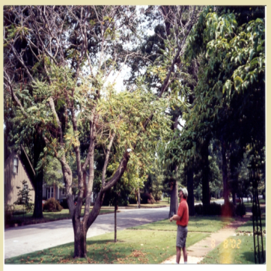
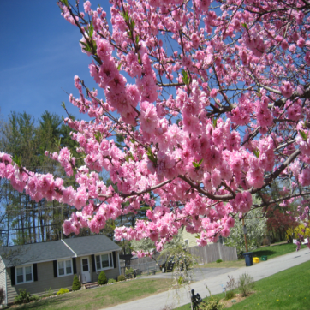
Consider…….
The intended function of the tree
The characteristics of the site
The desired qualities of the tree
Notes:
All of these factors enter into the decision of what trees to plant.
If the intended function of the tree is to intercept rainfall, then we need to choose tree species that have the most leaf area.
But we also need to consider in what conditions that species of tree will thrive. Is the site sunny or shady? Is the soil composed of clay or sand or a mix? Is there enough room for a large tree, given the planting site and its surroundings?
And finally, so that the tree will be acceptable to its human neighbors, we should think about the characteristics of the tree. Would the landowner prefer a flowering tree, or one that has great fall color? Will it be a problem if fruit is dropped on the sidewalk?

Slide 11
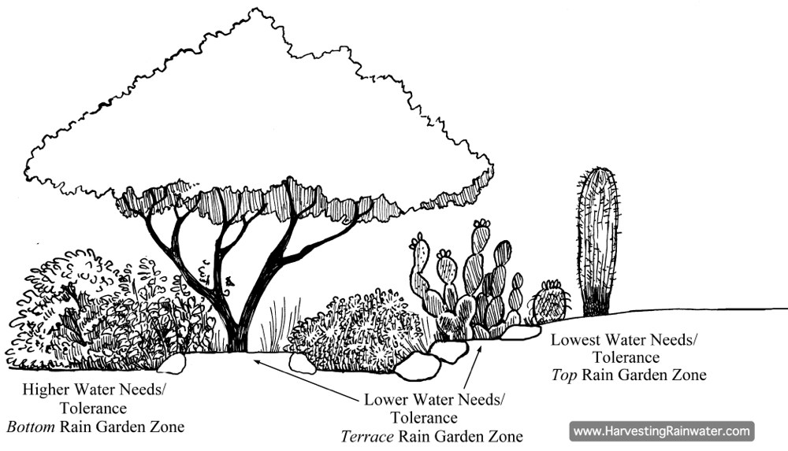
Moisture Zones
Transition Zone
Wet Zone
Mesic (middle) Zone
Bald cypress
Swamp white oak
Black willow
Serviceberry
Red maple
Sweet gum
Sycamore
Pin oak
Notes:
For the purposes of planning Green Stormwater Infrastructure practices like rain gardens, the moisture level of the soil is tantamount. We can divide the soil conditions into three categories.
- In the Wet zone, the soil surface will be the lowest and will hold the most water for the greatest amount of time, usually up to 6 inches. The plants chosen for this area are tolerant of flooded conditions with standing water for a period of time. Ideally the water should infiltrate within 24 hours.
-In the Mesic (or middle) zone, the soil will hold water but will drain much sooner than in the wet zone. This zone is likely to hold several inches of water during and immediately after a rain event. The plants can tolerate wet feet for a short period of time, but not standing water.
The Transition zone is likely to be the highest and driest. It’s the zone between the rain garden and the non-garden area. This area will receive water infrequently, during very heavy rain events, and will drain the fastest. Almost any typical garden plant will work in this zone.

Slide 12

Tree Stocks
Notes:
Trees are offered by plant nurseries in three different stock forms.

Slide 13
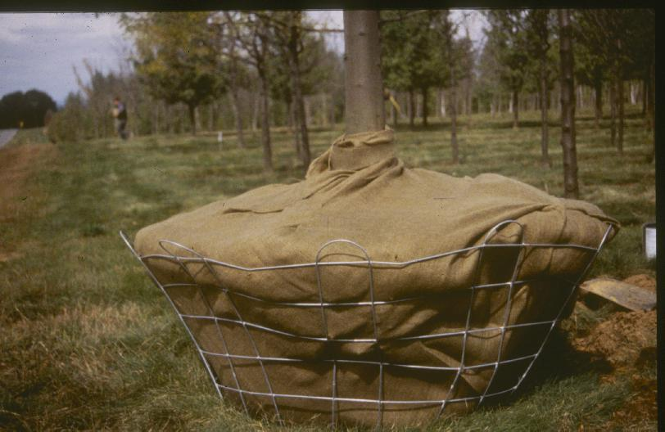
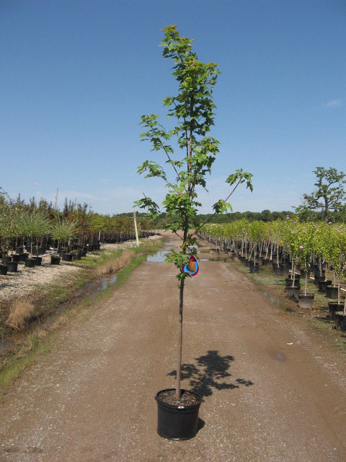
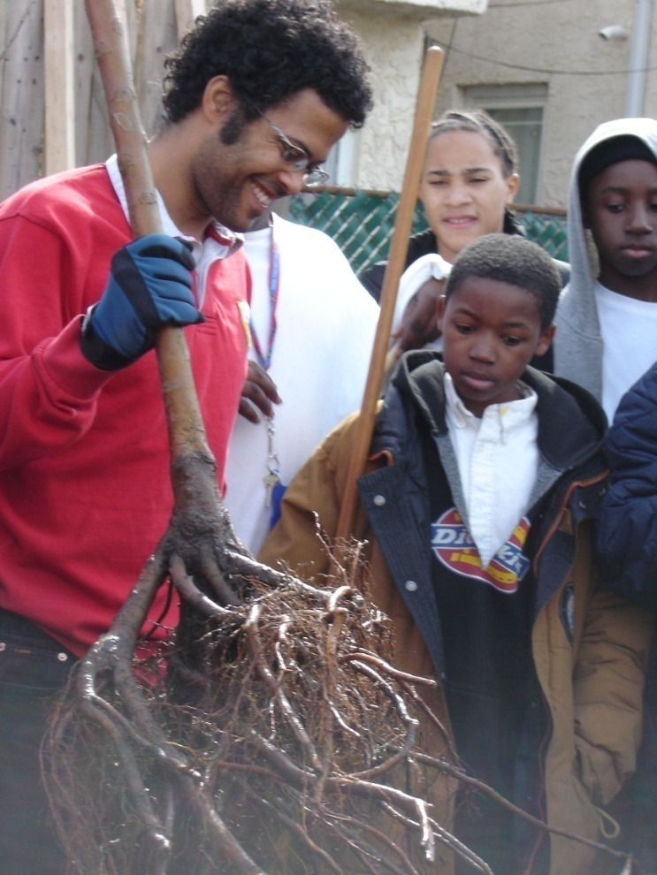
Tree Stock Choices
Container
Balled and Burlapped
Bare Root
Notes:
The three forms are Balled and Burlapped, also known as B&B, container grown, and bare root. Each of these has its own advantages and disadvantages, which must all be taken into consideration when planning a green infrastructure planting.

Slide 14
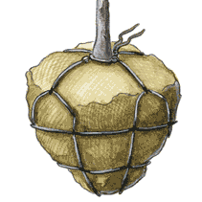
Balled and Burlapped (B&B)
Advantages
  Plant anytime
  Larger stock
Disadvantages
  Fewer roots
  Often planted poorly
  Heavy!!
Notes:
Since immediate sturdiness is important to many urban municipalities, they will choose large balled and burlapped, or B&B, trees with 2” caliper or more. B&B trees can be planted in virtually any season, but they are very heavy and moving them may require large equipment that could cause compaction of soils during installation in bio-retention systems, where porosity is important.
At the nursery, the harvesting technique for balled and burlapped trees cuts off a lot of the supporting roots, so it can take these trees a relatively long time to become established in their new location.
They are also frequently planted carelessly, leaving the burlap and wire baskets in place. This leads to early tree failure.

Slide 15
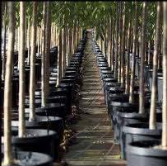
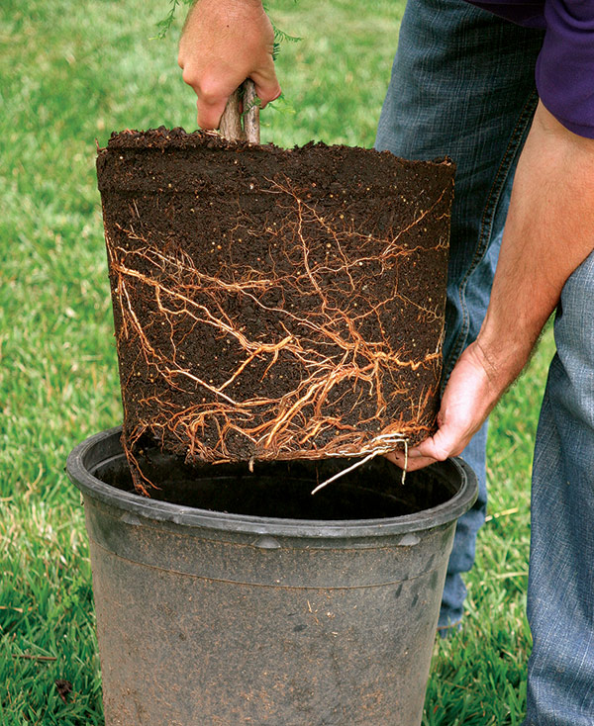
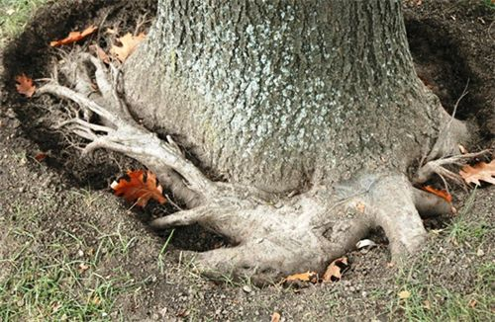
Container
Advantages
  Plant anytime
  100% of roots
  Lighter weight than B&B
Disadvantages
  Girdling roots
  Often planted poorly
Notes:
Container grown trees are transplanted with all of their roots, which is an advantage. They also can be planted at any time of year, but proper planting technique is important. Sometimes the trees are planted too deeply in the containers, with the trunk’s bark buried underground. When the roots reach the edge of the container, the roots may start to circle. These are called girdling roots, and when they grow large, they can strangle the trunk of the tree. It is important to free these circling roots to ensure that they will grow radially outward from the trunk.

Slide 16
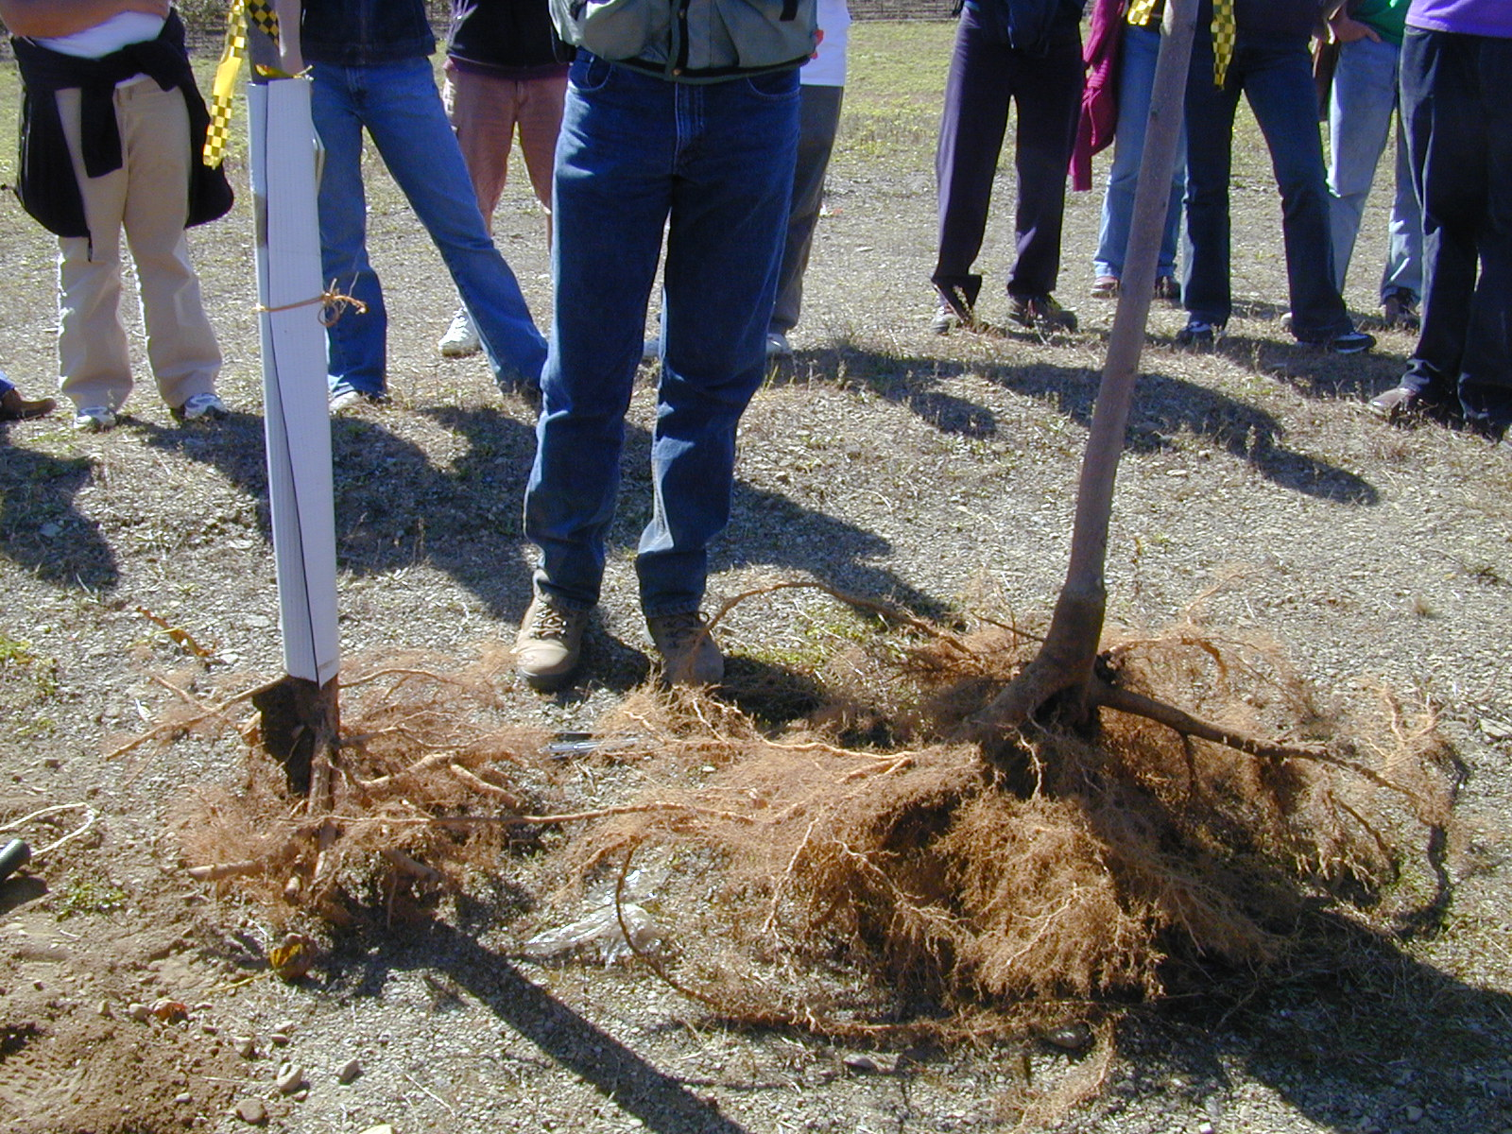
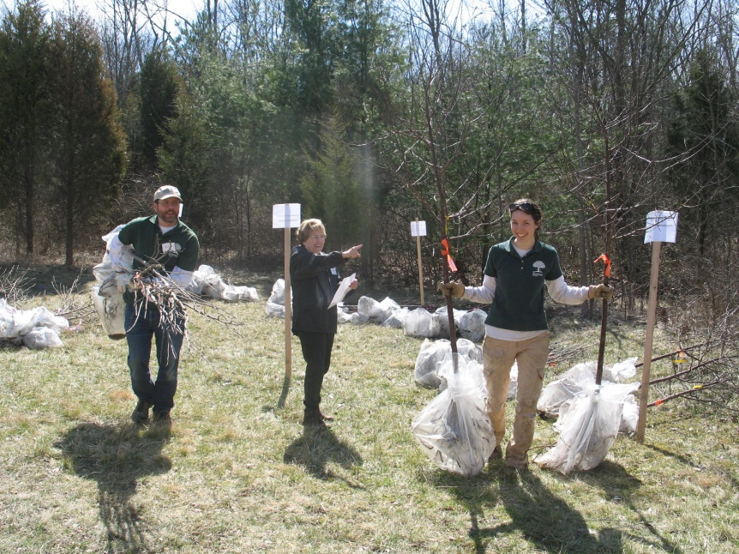
Bare Root
Advantages:
  Easy handling
    -Transport
    -Planting
  Inexpensive
  200% more roots
  than B&B
  Visible root system
  85% survival rate
B&B
Bare root
Notes:
Bare root trees are the easiest to handle and plant properly. There are more roots than harvested B&B trees, and any flaws in their root structure can be corrected immediately, thus preventing the girdling roots that often persist with container grown trees. It is easy to see exactly how deep to plant the trees.

Slide 17
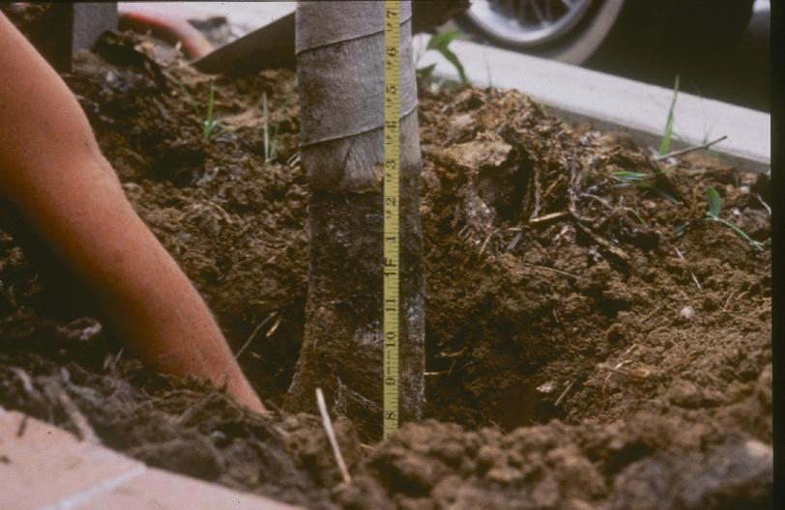
No More Hidden Problems…
Bare Root:
Buried root flare
Notes:
Bare root trees reveal all the possible flaws that are hidden in B&B and container stock. If a tree was buried too deep in the nursery, it can be corrected by planting with the root flare above ground.

Slide 18
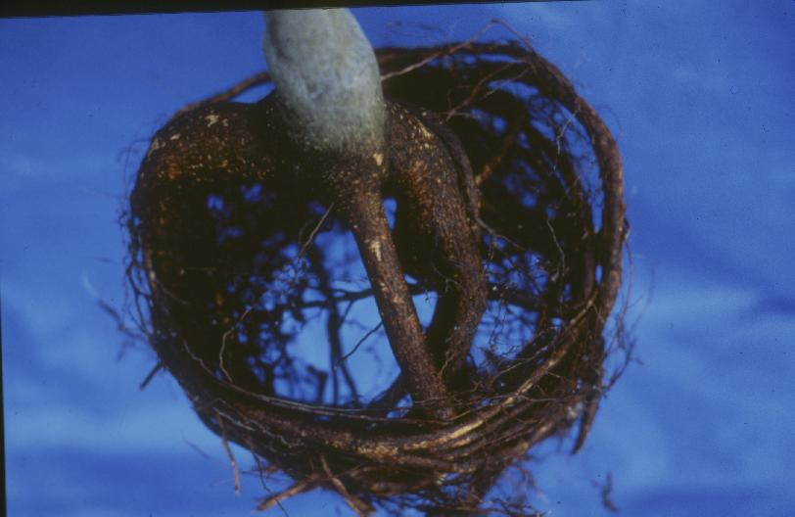
No More Hidden Problems…
Bare Root:
Circling roots
Notes:
Any circling roots can be coaxed to stretch outward, or cut to allow them to continue their growth radially.

Slide 19
No More Hidden Problems…
Bare Root:
J-Roots
Notes:
J-roots are the result of mechanical planting of seedlings in the nursery. This tree will lack supporting roots on one side and will be unstable.

Slide 20
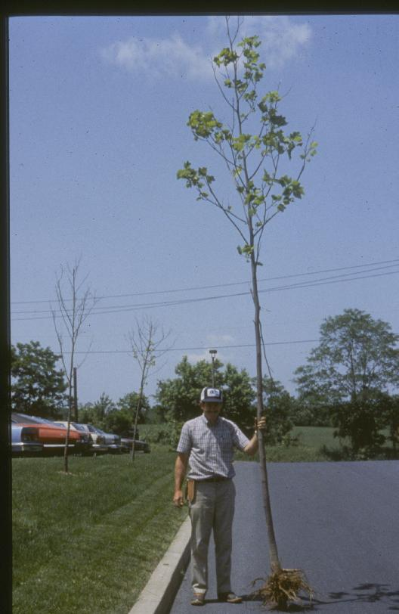
Bare Root
Disadvantages
  Must plant quickly
  Restricted planting season
  Root exposure
Photo credit: Bill Elmendorf
Notes:
However, the roots of bare root trees have no soil to protect them from the elements and so these trees must be protected from freezing or drying and should be planted very soon after harvesting. They must be harvested only during dormancy, when their need for water is reduced.

Slide 21
How Trees Work
Notes:
Here’s what we need to know about tree biology in order to plant and care for them correctly.

Slide 22
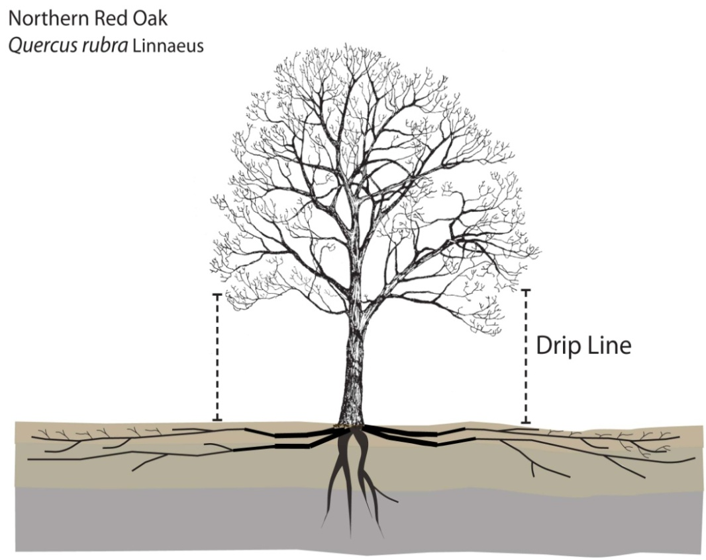
Trees Are Made Up Of…
  Shoots
  (above-ground parts)
    Trunk
    Root Flare
    Branches
    Stems
    Leaves
  Roots (below-ground parts)
    Root zones
    Root structure
Notes:
We’ll start at the bottom and work our way up.
The roots, of course, are the part of the tree that grows underground.
The roots have several functions: they anchor the tree; take up nutrients and water and transport these to the rest of the tree. In many respects, the roots are the most important part of the tree.

Slide 23
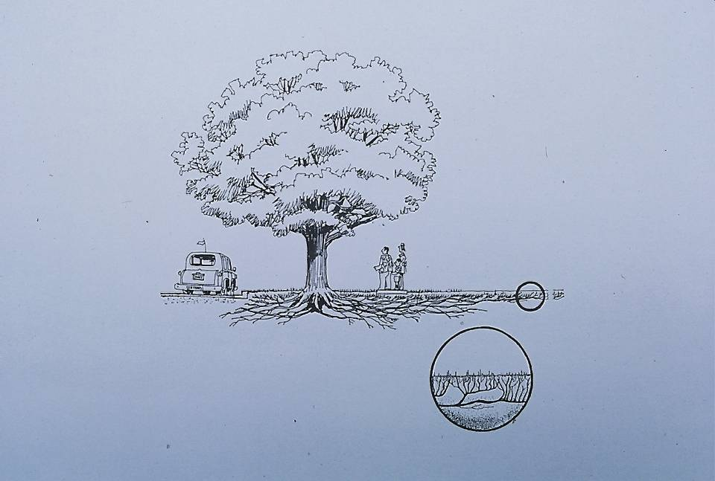
The Root of the Matter…
Notes:
The roots need access to water and air in order to function and survive. Soil spaces where water and air can be held are mainly located in the top 12 to 18” of soil. Deeper than that, there is not adequate exchange of water and air.
Case in point: This tree has NOT grown its roots underneath the paved street, where the soil is compacted by traffic and no air and water exchange occurs, but instead spreads its roots further on the other side where they can get what it need.
Vascular plants cannot grow where the soil is too compacted – you see this on college campuses where repeated foot traffic causes grass to die, and bare soil paths are created.

Slide 24
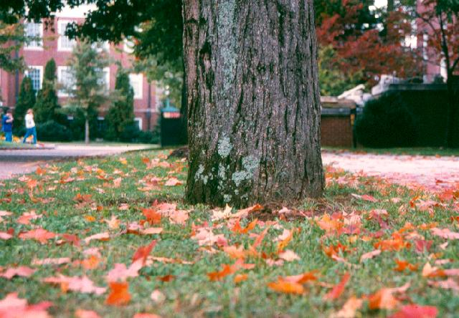
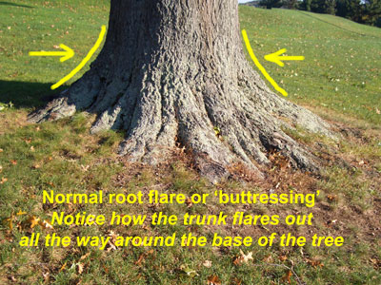
Root Flare or Buttressing
Notes:
The root flare is also known as the trunk flare, and is the area where the trunk transitions to root. There should be an obvious curvature at the base of the tree if the tree has been properly planted.

Slide 25
Root Flare or Buttressing
Buried root flare
Notes:
If the tree has no flare showing above ground, it is likely that the tree has been buried too deep, with a portion of its trunk now located below ground. Since the outer bark is designed to be in a dry and light location, it is very liable to rot when it is buried in the dark and wet ground. In addition, the tree may send out additional roots, called adventitious roots, attempting to access the air and water closer to the surface. These roots frequently become girdling roots.

Slide 26
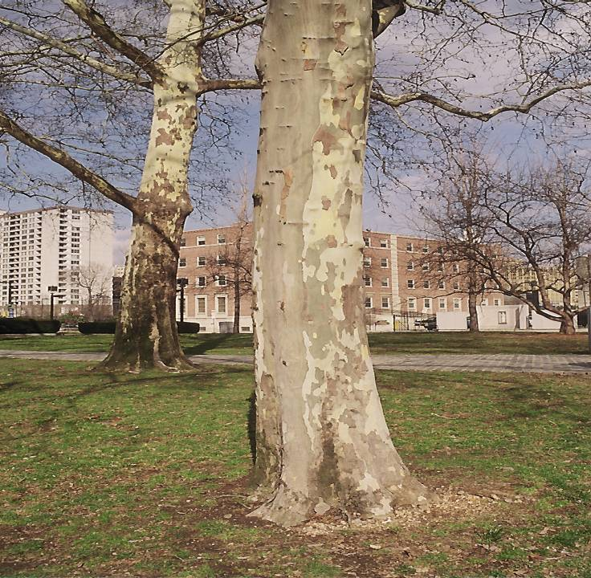
Probable girdling root
Notes:
This tree has a problem with some of its roots. Although there is a visible root flare on the right side, there is probably a girdling root on the left side, which has prevented the tree from establishing a good root flare. The tree isn’t as well anchored on that side.
Attention to roots while planting a tree is the first step toward a healthy, long-living tree.

Slide 27
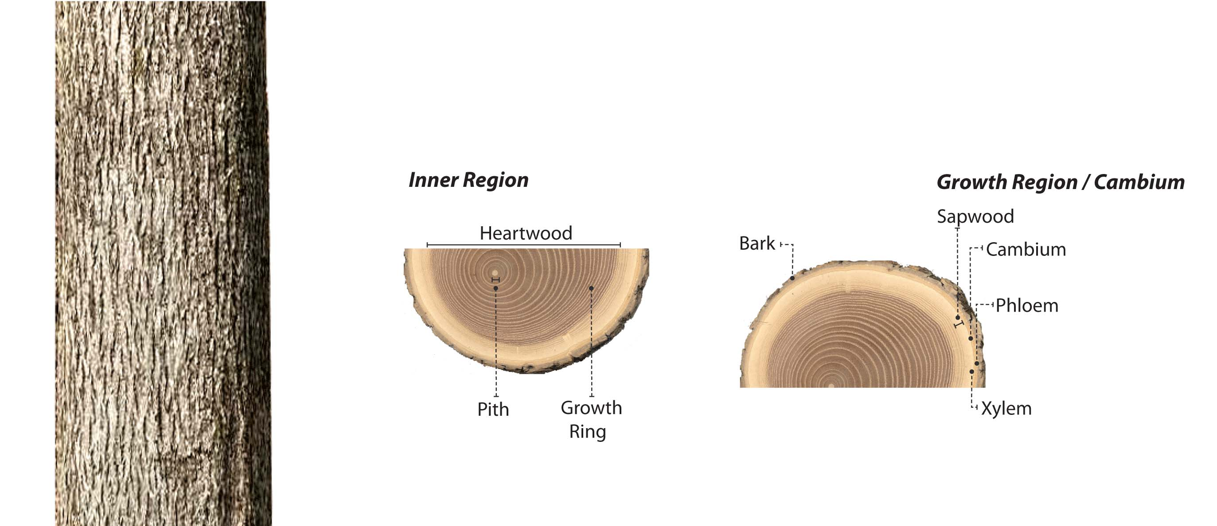
Tree Trunk Growth Region
Notes:
A cross section of the trunk of a tree reveals a very narrow band of living tissue layers just inside the bark.
Immediately inside is the phloem, a thin layer of “pipes” that carry glucose from the leaves to other parts of the tree, including the roots. Inside the phloem is the cambium, a very thin layer of undifferentiated cells that can become whatever the tree needs – phloem or xylem (which is the next layer in). The xylem is a system of “pipes” that carry water and nutrients from the roots up to the leaves and other parts of the tree. The creation of phloem and xylem cells continues throughout the growing season, but happens faster in the early part of the year and slows down in the fall. This is what causes the growth rings, which you can count to discover the age of the tree.

Slide 28
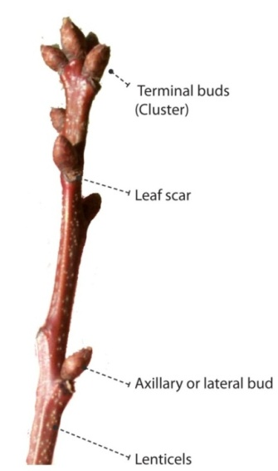
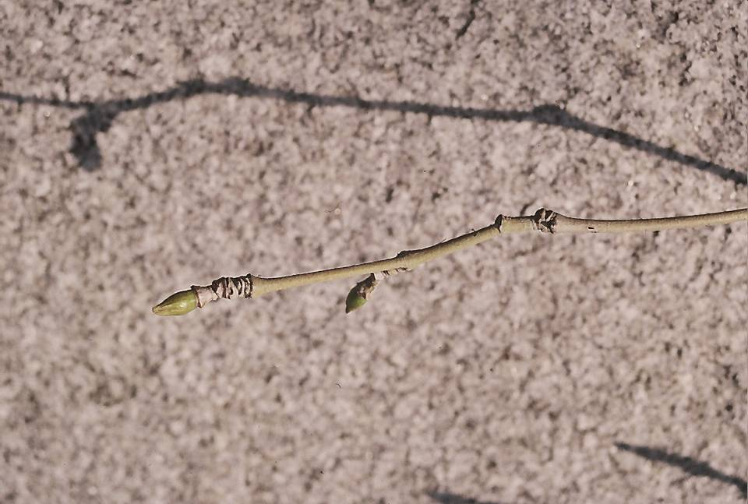
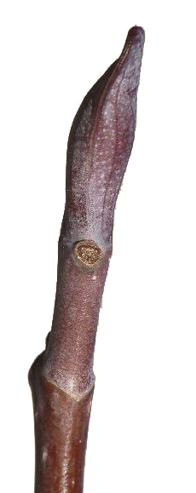
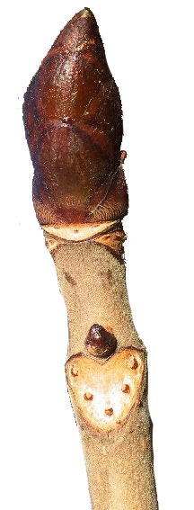
Twigs
One Year’s Growth
Notes:
A way to judge the growth rate of the tree is by the length of twig growth between the terminal bud at the end of the twig and the ridges that indicate where last year’s terminal bud was located. As the tree ages, the twig and trunk growth may slow, but there should still be discernible growth each year.
The photo on the left shows what a year’s growth looks like.

Slide 29
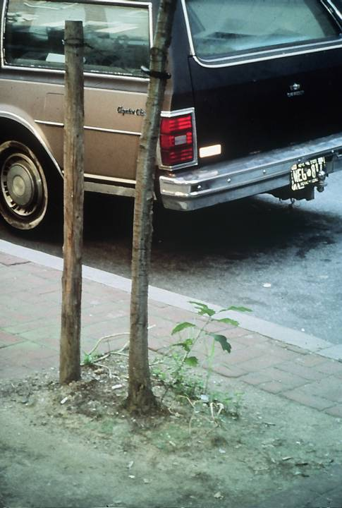
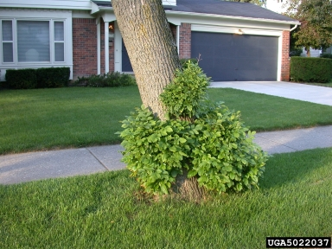
http://www.ca.uky.edu/caps/eab_epicormic.asp
Root
Suckers
Notes:
Suckers grow at the base of a tree as a cry for help. The branching is very weak, so you should remove the suckers. Don’t just cut them off – if you cut off one, two will grow. If you cut off those two, four will grow. Instead, twist and pull the suckers when they are small to remove the growth tissue at the base of the sucker.

Slide 30
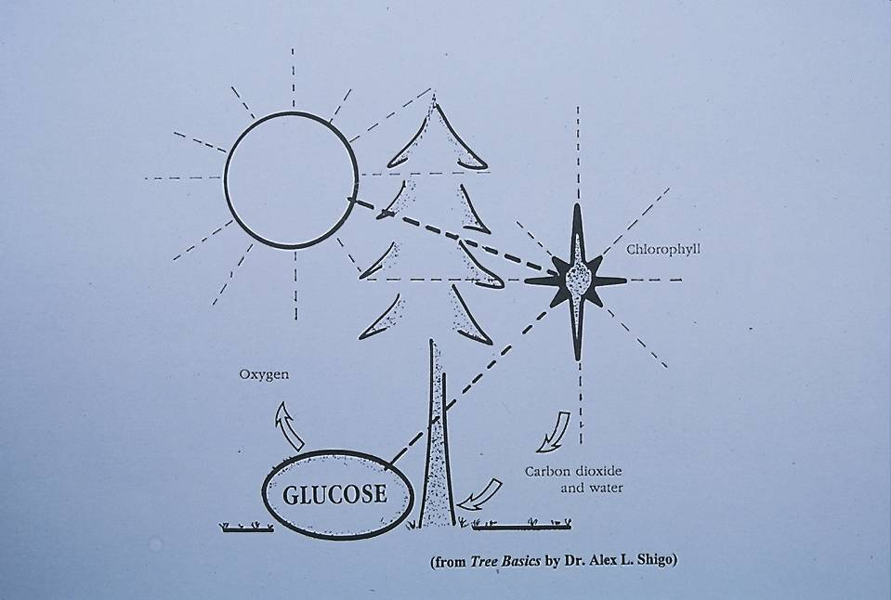
Photosynthesis
Notes:
In photosynthesis, chlorophyll in the leaf collects energy from the sun, and through a chemical reaction combines carbon dioxide and water to create glucose – a sugar. This glucose is used by the tree to grow and live, and through a process called respiration, is broken down into energy, water vapor and oxygen.

Slide 31
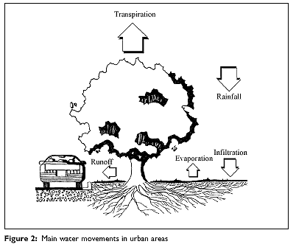
Transpiration & the Water Cycle
Trees can lose more water than they take in
90% of water taken up by the tree – lost by transpiration
Transpired water cools surrounding air
Notes:
Trees also release water vapor into the atmosphere through transpiration from their leaves, which is akin to perspiration in human beings.
Between respiration and transpiration, most of the water taken up by the tree is either used or released. It is partly through these processes that trees function as Green Infrastructure.

Slide 32
Tree Planting:
Leaves Up, Roots Down
Notes:
Now that we know how a tree works, it is easy to understand how important it is to plant the tree properly.

Slide 33
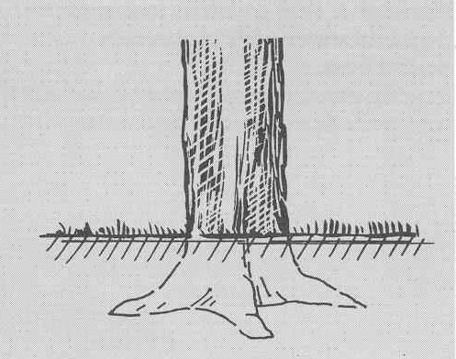

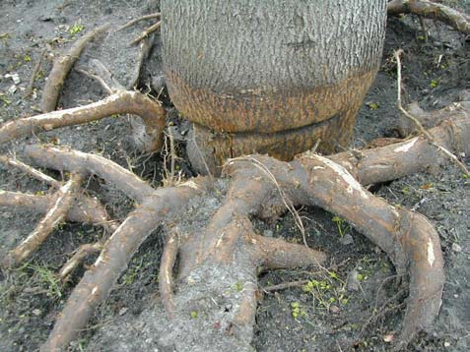
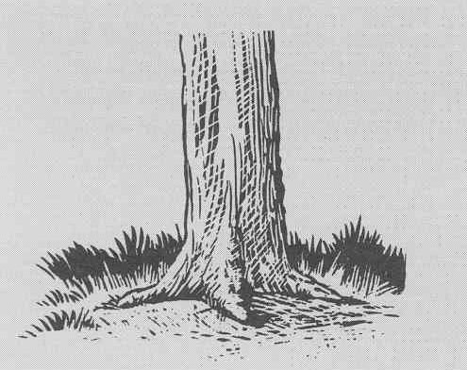
Buried Root Flares Kill Trees
Too deep!
Correct
Notes:
The roots of trees buried too deep cannot get the oxygen and water that they need to survive. Plant young trees with the first major root just below the surface of the ground. This allows the root flair to be above ground where it belongs.
Burying too deep is a major reason why trees do not survive. This causes additional roots, called adventitious roots, to form closer to the surface, where they often circle and strangle the trunk.
The photo on the lower left shows a depression where a root was girdling the trunk, but was removed. The larger circling roots will also become a problem as the trunk expands. The lighter colored bark on the trunk indicates the level where the soil had been – clearly this tree was planted too deep.

Slide 34
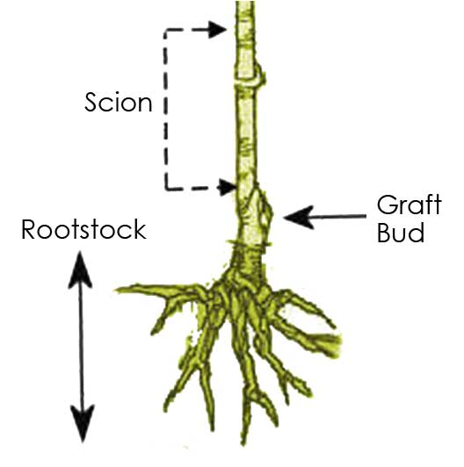
Distinguish Root Graft from Root Flare
Notes:
A graft is often mistaken for the root flare. The graft is a swollen area where the strong root stock from one species is attached to the trunk of another tree that has desired characteristics such as a particular color of flower. Although the trunk is swollen there, it is NOT where the first root emerges from the stem.

Slide 35
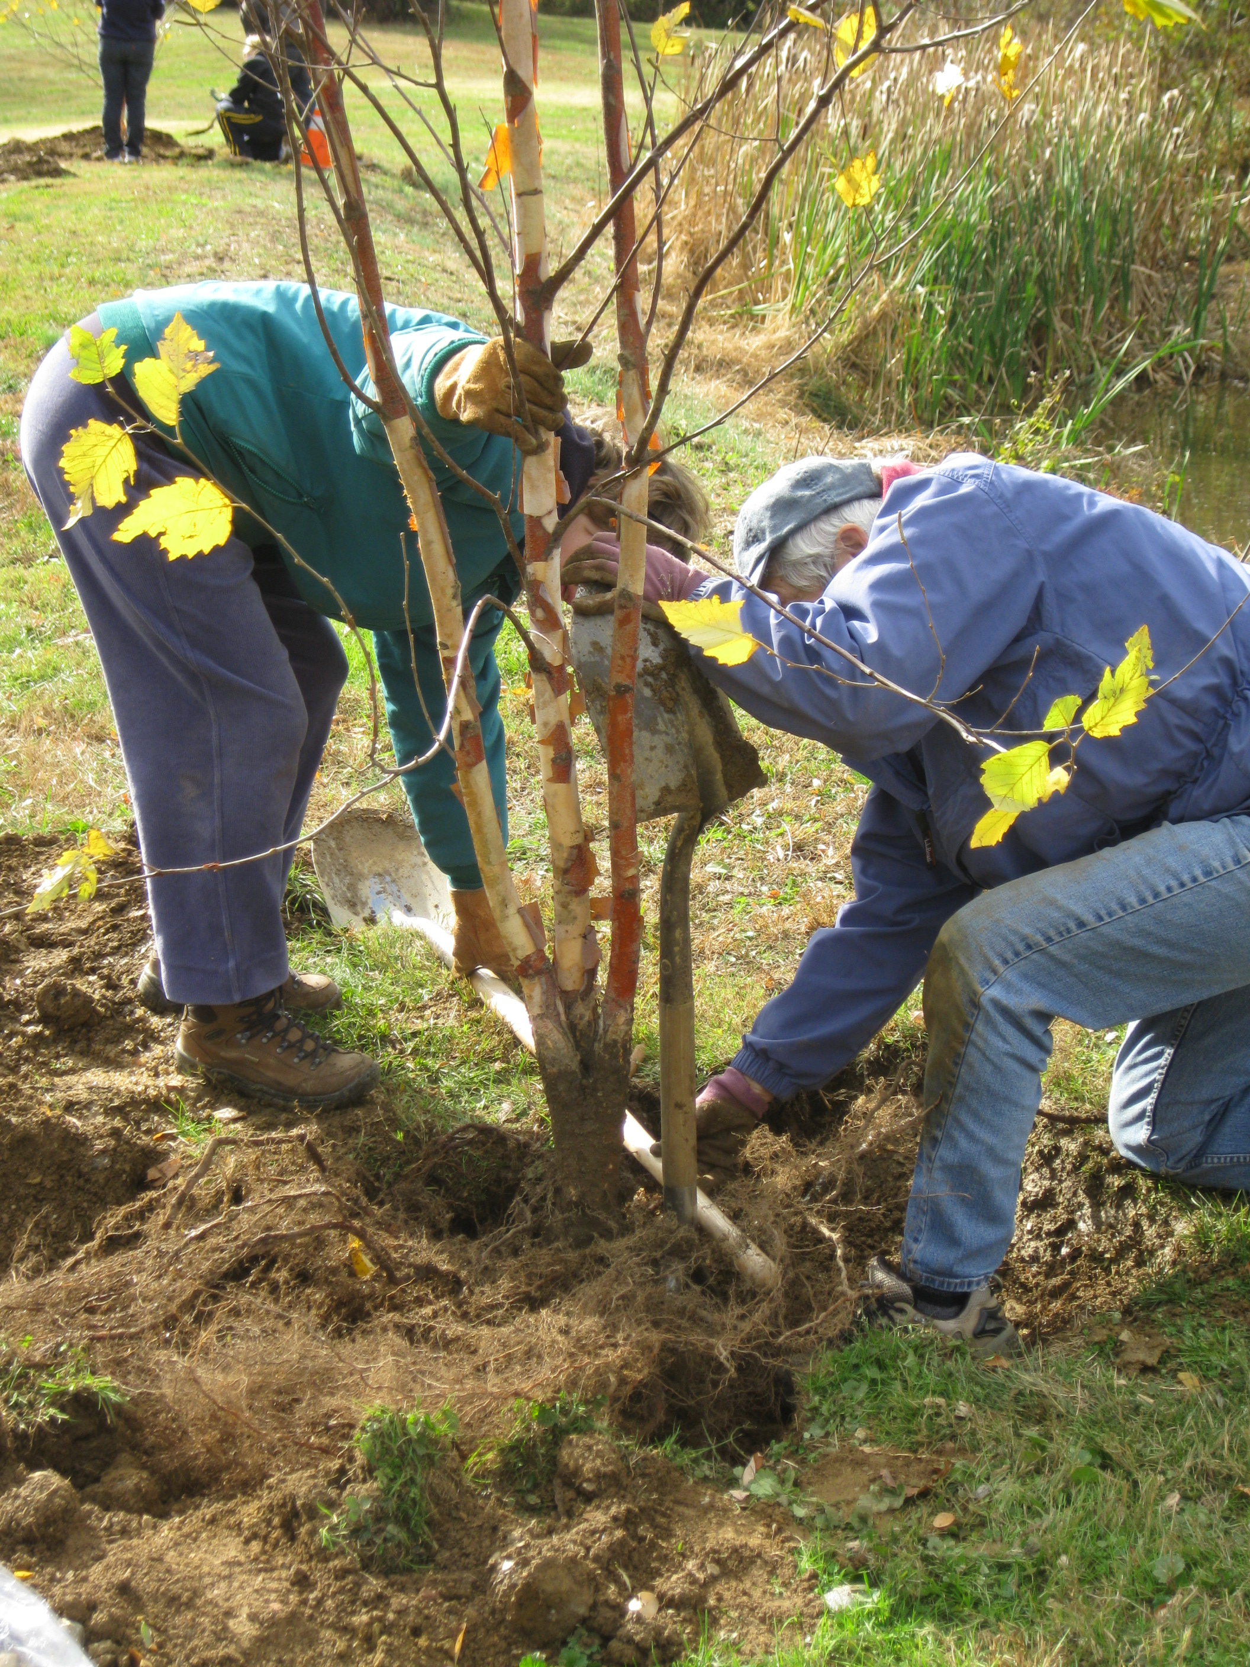

Attend to Your Roots!
Roots spread radially, some at the surface.
Notes:
To plant properly, measure the depth of the hole in comparison to the level of the root flare. Spread the roots while planting so that they extend out like spokes of a wheel. This gives them the chance to become strong anchoring roots in all directions.

Slide 36
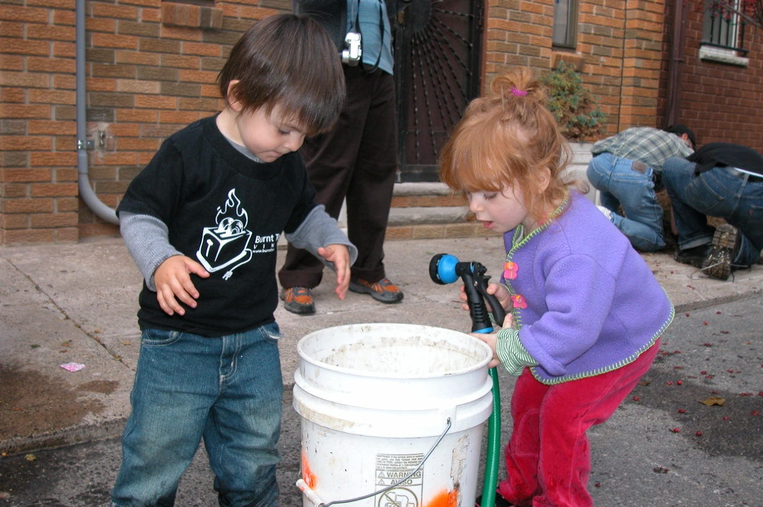
Water thoroughly to:
*settle the soil
*remove any air pockets
*reduce transplant shock.
Don’t Forget to Water Your Tree
Notes:
Watering at planting time is especially critical in order to settle the soil, filling any air pockets with soil and giving the tree a good initial drink after the shock of being transplanted.

Slide 37
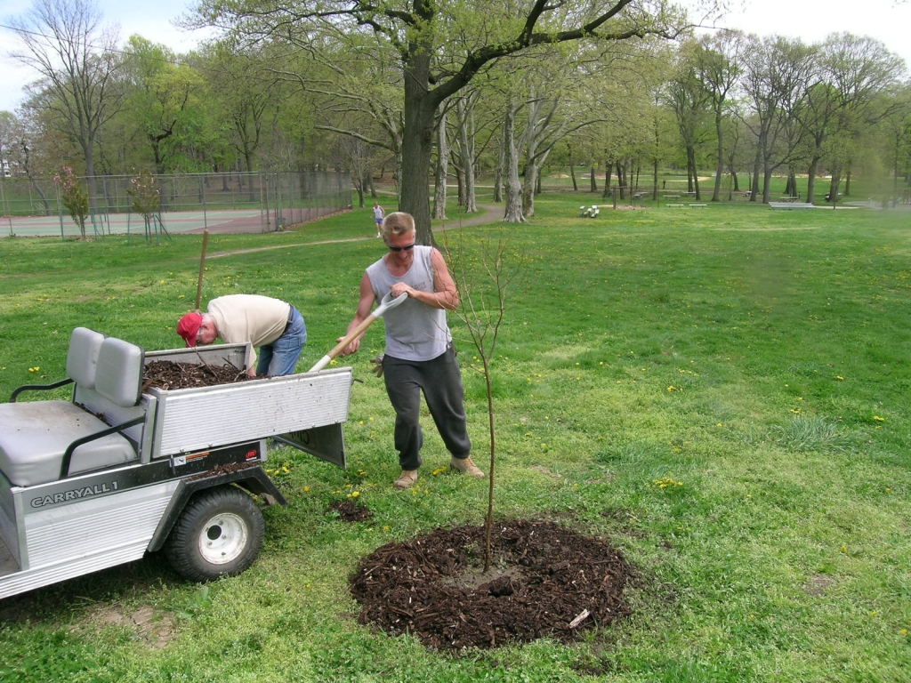
Mulch Using the 3-3-3 Rule
Notes:
Mulch is important for all trees, because it imitates the leaf drop that happens in the forest. Mulch holds moisture in the soil underneath, prevents weeds, moderates soil temperature, provides nutrients when it decomposes, and prevents mowers and string trimmers from damaging the tree.
The easiest way to remember the proper mulching technique is the 3-3-3 rule. Apply hardwood mulch no deeper than 3 inches, placed no closer than 3 inches from the trunk and never touching it, and 3 feet in radius if possible.

Slide 38
Tree Care:
The Basics
Notes:
The first 2 years after a tree is transplanted are the most critical for a long, healthy life. This is the time during which the roots grow enough to support the tree with water, nutrients and stability – known as the establishment period.

Slide 39
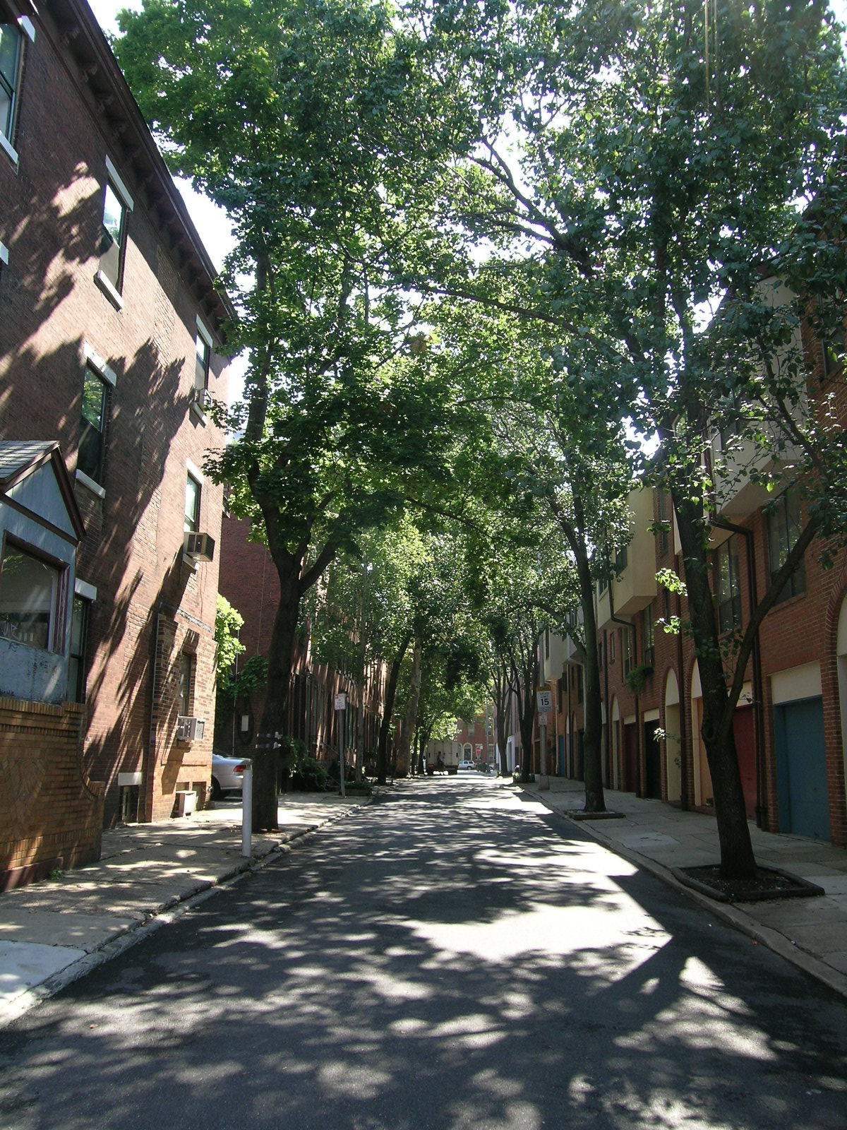
Trees Need:
Air
Water
Nutrients
S p a c e
Notes:
Just like any plant, all trees need air, water, nutrients and space to grow – regardless of whether planted in a rain garden, a riparian buffer or a tree pit.

Slide 40

Cultivate Beneath Trees
Loosen compacted
soil
Remove grass and
weeds
Twist and pull suckers
PHS Tree Tenders
Notes:
If the soil over the roots is compacted or covered with competing plants, water and air will not penetrate to the roots where needed. It is simple to carefully cultivate the area around the trunk, loosening the soil and removing the weeds.

Slide 41

Mulch Is a Must! It….
Moderates soil temperature
Reduces lawn mower damage
H
Keeps weeds and grass from competing with young trees
Releases nutrients into soil
PH
S
Notes:
Mulch imitates the roles of fallen leaves in a forest – replenishing nutrients to the soil, moderating the temperature and preventing competitors from sprouting. In an urban setting, it also prevents lawnmower damage.

Slide 42

Mulch Is a Must! It….
Moderates soil temperature
Reduces lawn mower damage
H
Keeps weeds and grass from competing with young trees
Releases nutrients into soil
PH
S
Notes:
Research has shown that turf grass inhibits the healthy growth of tree roots. So it is important to prevent turf from growing next to the trunks of trees.

Slide 43


Lookin’ Good?
Notes:
Remember the 3-3-3 rule when re-applying mulch. Never build the mulch up into a “mulch volcano” around the trunk or allow it to touch the trunk! This can rot the bark and leave the trunk susceptible to diseases and pests.

Slide 44


Water
15-20 gallons applied all at one time each week
Slow and deep watering
Notes:
A newly planted tree should be watered deeply once a week for the first two years. If it rains, that counts! Watering bags are often used to save time, but they only work if they are FILLED! This one could use some water.
A less expensive and more reliable method is to drill several small holes in a 5-gallon bucket and fill it three times for 15 gallons of water that seep slowly into the soil.

Slide 45

Work Safely
Never work off a ladder!
Never climb trees!
Never use a chainsaw above your head!
If you can’t reach it –
hire a Certified Arborist.
Never prune trees near utility lines! Instead consult your local utility company.
Slide credit: Vinnie Cotrone
Notes:
Remain on the ground when working with trees. No one should work off of a ladder, especially if using power tools.
Hire qualified professionals such as ISA Certified Arborists to handle tree work that is beyond your expertise. This includes any tree that is within 10 feet of an energized utility line.
All pruning and tree work must adhere to ANSI Z133 safety standards and state and local regulations.

Slide 46

Tools
Bypass Pruners
Up to ½ diameter
Notes:
Use bypass pruners to remove branches up to ½ inch in diameter. Bypass tools are like scissors. The two sharp blades move past one another, making a clean cut.

Slide 47

Tools
Anvil Type Pruners
Not recommended:
can crush branch tissue
Notes:
Anvil pruners have one sharp blade that pushes against a flat surface. Do not use anvil pruners on living branches because they will damage the tissues.

Slide 48

Tools
Bypass Loppers
½” to 2” diameter
Notes:
For branches larger than ½ inch but less than 2 inches, a bypass lopper is best.

Slide 49

Tools
Hand Saw
Over 2” in diameter
Notes:
For branches over 2 inches in diameter, use a hand saw so that the cut will be clean and precise.

Slide 50

Tree Pruning
What Branches Should Be Removed?
  • The 3-Ds: Dead, Diseased, Damaged
  • Rubbing and Crossing Branches
  • Tight V Branch Union with Included Bark
  • Root Suckers from base of Tree

Slide 51

1
2
3
4
Notes:
Branch wood and stem wood don’t form at the same time! A branch lays down wood early in the spring as in diagram #1. Later in the year, the trunk lays down its wood, enveloping the branch wood where the two meet, in diagram #2. The same thing happens each year. As a result, branch wood and trunk wood form a strong branch union. The wood at the union between the codominant stem on the right does not overlap. For that reason, the union between codominant stems is typically weaker than the union between a branch and the trunk. If the two arms form a V-shaped union, the branch structure is unstable.

Slide 52

Branch bark ridge present
      Some branch unions have a prominent branch bark ridge
Notes:
One indicator of a good branch attachment is a prominent branch bark ridge. It is formed on the upper side of the branch union. It is the result of new branch wood and new trunk wood pushing up into the union.

Slide 53

No branch bark ridge
Collar
Notes:
Some trees never develop a branch bark ridge. Another indicator of a strong branch union is a swollen area at the base of the branch called the branch collar. The branch collar is the result of years of overlapping branch and trunk wood shown in previous slides. The branch collar contains cells with protective qualities in what is called the Branch Protection Zone. These cells promote the formation of callous wood when the branch is removed or wounded. For this reason it is important not to damage the branch collar when pruning.

Slide 54


GOOD!
Nicked
Notes:
The tree on the left had a branch properly removed, without damaging the branch collar. You can see that the callous wood has formed completely around the wound, sealing off the area from invasion by disease and pests.
The tree on the right had its branch collar nicked at the top, so the protective callous wood could not completely form.

Slide 55

3 POINT CUT
PH
S
Notes:
To avoid damaging the trunk when removing a heavy branch, use a 3-Point Cut. This technique was not used in sample A on the left, so the weight of the branch ripped the trunk bark before a clean cut could be completed.
Sample B on the right shows the proper method. First, an undercut is made, approximately 1/3 of the diameter of the branch and about 3 inches from the trunk. Second, the bulk of the weight is removed by cutting through the branch further away from the trunk. The third and final cut is made just outside the branch collar.

Slide 56

Where is the final cut?
PH
S
Notes:
Here, the first two cuts have been made. Although the branch collar is not very obvious on this tree, it IS there.

Slide 57
PH
S
Notes:
The final cut should be as small as possible, but not nick the collar. Do not leave a long stub, which is harder for the tree to callous over.

Slide 58


Flush Cuts Injure the Stem
Notes:
These cuts were done poorly. They were flush cuts, which means that the branches were cut off right at the trunk. The cut on the left also ripped down the trunk bark, leaving a nasty wound that the tree will have a hard time closing over. The cut on the right nicked the branch collar badly, and the tree responded by sending out sprouts.

Slide 59
PHS Resources Available
www.PHSonline.org
How to Plant Videos
  Container
  B&B
  Bare Root
Basic Care Videos
  Watering
  Mulching
  Weeding
  Pruning
Gold Medal Tree Choices
Tree Tenders Training (ISA Accredited)
Notes:
Excellent resources are available online, including the PHS website listed here. The Tree Tenders video library includes training videos for proper tree planting and care.

Slide 60
You Learned:
What role trees play in stormwater management
How we can choose the best trees for the purpose
What we need to know about tree biology for understanding maintenance practices
How we can establish and maintain trees for best growth.
Notes:
We hope you now have an understanding of the role of trees in stormwater management. In this presentation you have learned:
Why trees are an important contributor to green infrastructure and what role they play in stormwater management;
How to choose the best trees for the purpose;
Basic tree biology for understanding maintenance practices;
How to plant, establish and maintain trees for best growth.

Slide 61




THANK YOU TO OUR
FUNDER & PARTNERS
Pennsylvania Horticultural Society
100 North 20th Street
Philadelphia, PA 19103
www.phsonline.org
Notes:
This concludes this presentation on Trees, Stormwater and Green Infrastructure. Thank you to our funder – the US Environmental Protection Agency Region III, and partners PHS, AKRF, Inc. and GreenTreks Network, which helped produce this series.

